Slide 1

Presented By: Vishal Ramesh Nishad
Crime Hotspot Detection

Slide 2
Agenda
Introduction
Data Overview
Exploratory Data Analysis (EDA)
Feature engineering
Model Selection
Model Evaluation
Results
Conclusion

Slide 3

In this project, we leverage machine learning to predict crime hotspots within Los Angeles, based on factors such as demographics, weapon usage, and area-specific trends. By identifying these hotspots, the project aims to enhance community safety and provide data-driven recommendations for better security measures.
Introduction

Slide 4
Goal of the Project
The primary goal of this project is to build a crime hotspot prediction model to:
Detect prime crime hotspots across different areas.
Identify high-risk locations with significant crime activity.
Provide actionable insights to strengthen community safety initiatives.
Foster collaboration with local law enforcement for targeted interventions.
Use advanced visualizations to effectively communicate crime severity and hotspot locations.
Through this endeavor, the project aims to enhance community safety, promote proactive crime prevention measures, and uphold a commitment to data-driven solutions for public safety.

Slide 5
Data Overview
Dataset Details
Number of Rows: 901,357
Number of Columns: 28
Key Features:
DR_NO: Unique identifier for each case.
Date Rptd: The date the crime was reported.
DATE OCC: The date the crime occurred.
TIME OCC: The time the crime occurred.
AREA NAME: The name of the area where the crime occurred.
Crm Cd Desc: Description of the crime type.
Vict Age: Age of the victim.
Vict Sex: Gender of the victim.
Weapon Desc: Description of the weapon used.
Status Desc: Final status of the crime case (e.g., Arrest Made, Investigation Continued).
LAT, LON: Latitude and Longitude for mapping the location of the crime.
Dataset Dimensions: The dataset has 901,357 rows and 28 columns, making it a robust source for analyzing crime patterns and predicting crime hotspots.
Data Challenges
High Missing Values:
Many columns contain significant missing values, which may impact the quality of the analysis.
Missing values need to be imputed, removed, or handled carefully to maintain model performance.
Irrelevant Columns:
1. Several columns may not contribute meaningfully to the analysis (e.g.,
Mocodes', 'Part 1-2', 'Crm Cd 2','Crm Cd 1', 'Crm Cd 3, etc
These columns will be dropped to focus on the most relevant features for crime hotspot. prediction

Slide 6
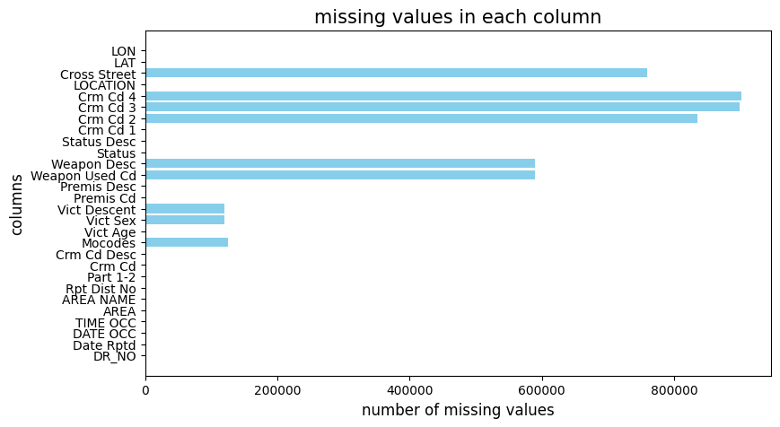
Exploratory Data Analysis (EDA)
Significant Missing Data: Columns like LON, LAT, LOCATION, and Crm Cd 4 have high missing values, affecting geographic and crime classification data.
Incomplete Status Info: Status Desc and weapon-related columns (Weapon Desc, Weapon Used Cd) are also poorly recorded.
Better Victim Data: Vict Sex, Vict Age, and Vict Descent have relatively fewer missing values.
Well-Recorded Columns: DR_NO, DATE RPTD, and AREA NAME have little to no missing data.
Actionable Step: Address missing values in critical columns to ensure better analysis.

Slide 7
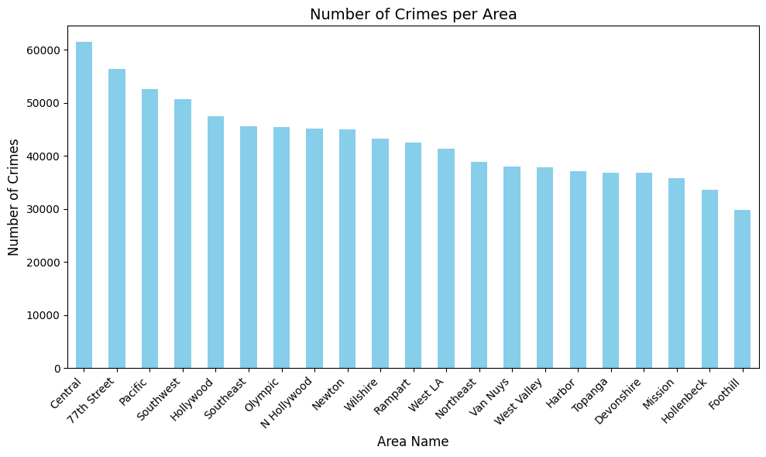
High Crime Areas:
Central and 77th Street are the top contributors to crime incidents, with Central leading significantly.
These areas likely require prioritized intervention and resource allocation.
Moderate Crime Areas:
Areas such as Hollywood, Southeast, and Southwest also show a considerable number of crimes, indicating the need for consistent monitoring and safety measures.
Lower Crime Areas:
Foothill, Hollenbeck, and Mission report fewer crimes compared to other areas. However, these regions should not be overlooked as localized trends may still pose safety concerns.
Key Recommendations:
High-crime areas, such as Central and 77th Street, should have targeted security enhancements and community policing strategies.
Data-driven visualizations like this enable stakeholders to make informed decisions about law enforcement deployment and community safety programs.

Slide 8
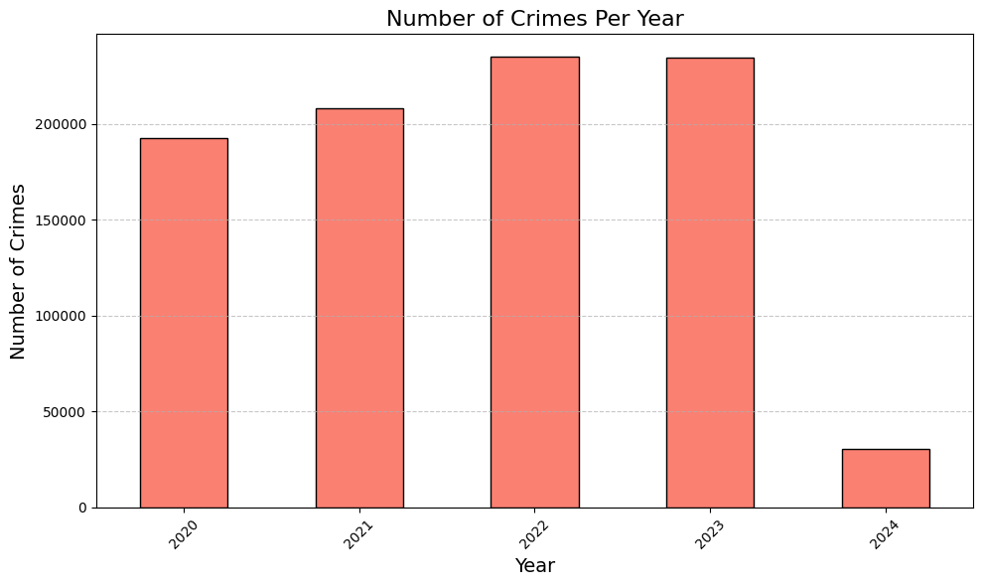
Steady Crime Rates (2020–2023):
Crime numbers appear consistent from 2020 to 2023, hovering around similar values exceeding 200,000 incidents annually.
This indicates a persistent level of crime activity requiring consistent law enforcement efforts.
Drop in 2024:
A sharp decline in reported crimes for 2024 is noticeable..

Slide 9
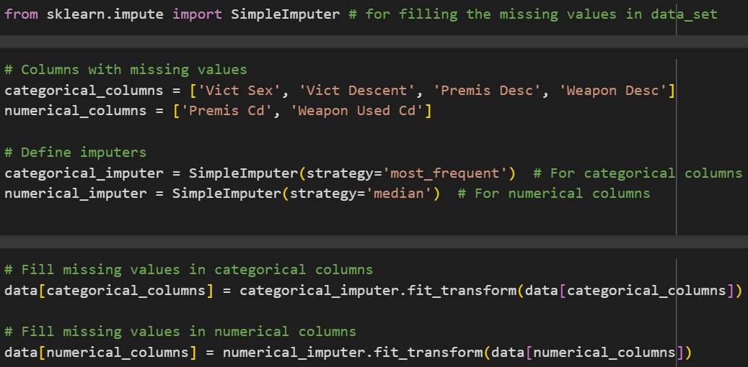
Feature engineering
Missing Value Handling:
Categorical columns: Imputed with the most frequent value.
Numerical columns: Imputed using the median to handle outliers.
Efficient Separation:
Columns are divided into categorical and numerical for appropriate processing.
Simple Imputer Usage:
Ensures consistent and standardized handling of missing values.
Improved Data Quality:
Ensures completeness of data for analysis and modeling.
Scalable Process:
Easily adaptable for additional columns or imputation strategies.

Slide 10
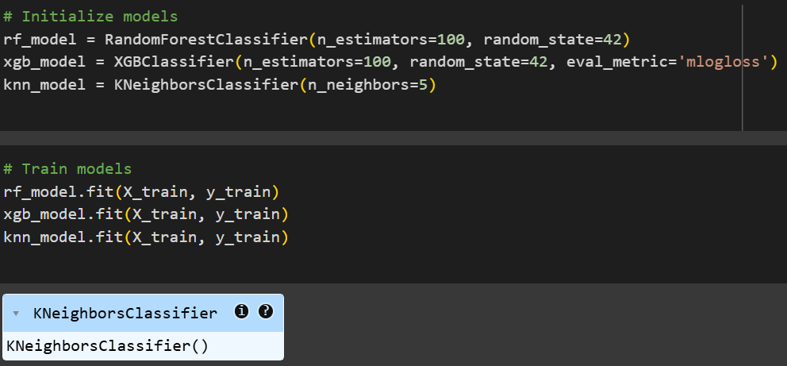
Model Selection
Three Models Initialized: Random Forest, XGBoost, and KNN.
Training: All models trained on the same dataset (X_train, y_train).
Diverse Algorithms: Ensemble (Random Forest, XGBoost) vs Instance-based (KNN).
Reproducibility: Consistent results with random_state
Basic Hyperparameters: Set for initial training, but can be fine-tuned.
Performance Evaluation: Compare models to identify the best-performing one.

Slide 11
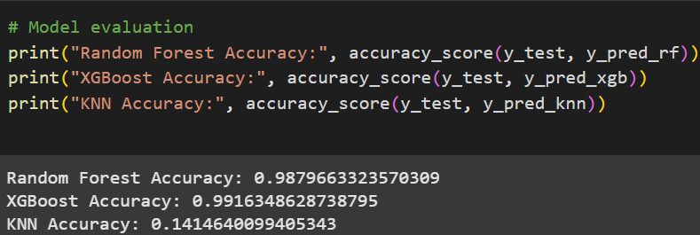
Model Evaluation
Accuracy Scores:
Random Forest: 98.79%
XGBoost: 99.16%
KNN: 14.14%
Top Performer:
XGBoost outperforms other models with the highest accuracy (99.16%).
KNN Performance:
KNN shows significantly low accuracy (14.14%), indicating it may not be suitable for this dataset or needs hyperparameter tuning.
Random Forest:
A strong contender with high accuracy (98.79%), only slightly behind XGBoost.
Conclusion:
XGBoost is the best model for this task based on accuracy. Further evaluation metrics (e.g., precision, recall) can confirm its reliability.

Slide 12
CLASSIFICATION REPORT
 | MODELS | PRECESSION | RECALL | F1-SCORE | SUPPORT
1 | RANDOM FORES CLASSIFIER | 0.99 | 0.99 | 0.99 | 16914
2 | XG BOOST CLASSIFIER | 0.99 | 0.99 | 0.99 | 16914
3 | KNN NEIGHBORS CLASSIFIER | 0.14 | 0.36 | 0.20 | 16914
We choose XG Boost over Random Forest because it offers better performance, handles imbalanced data more effectively, and provides advanced tuning options. Its speed, robustness to noise, and ability to capture complex patterns make it ideal for crime hotspot prediction

Slide 13
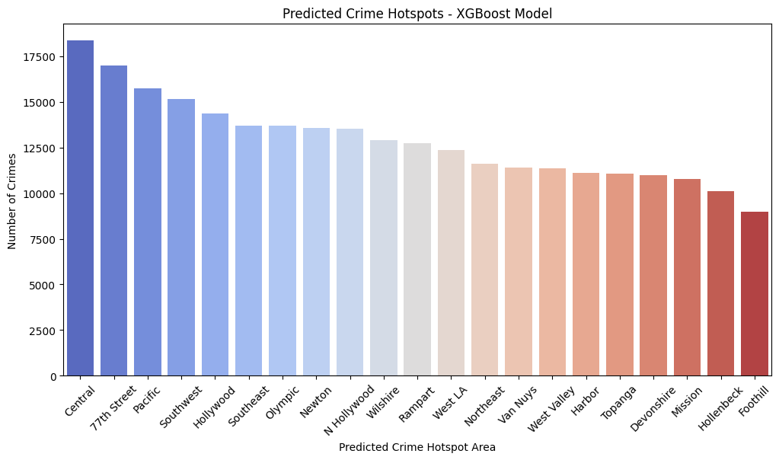
Results
predicted vs Actual Comparison:
Top Crime Area:
Predicted: Central
Actual: Central
Observation: The model accurately identifies Central as the top crime hotspot.
Second Rank:
Predicted: 77th Street
Actual: 77th Street
Observation: The model correctly predicts 77th Street as the second-highest area.
Low-Crime Area:
Predicted: Foothill
Actual: Foothill
Observation: Both predictions and actual data show Foothill as a low-crime area.
Overall Trend:
Predicted: Decline in crime count across areas from high to low.
Actual: Similar steady decline.
Observation: The model captures the overall trend effectively.
Key Differences:
Predicted: Slight underestimation in areas like Olympic.
Actual: Slightly higher counts in Olympic and mid-ranked areas.
Observation: Minor deviations in mid-level hotspots that may require further tuning.
Performance:
Observation: Predictions are highly aligned with actual trends, indicating strong performance by the XG Boost model.

Slide 14
Thank you
Presented by: vishal ramesh nishad

